Slide 1
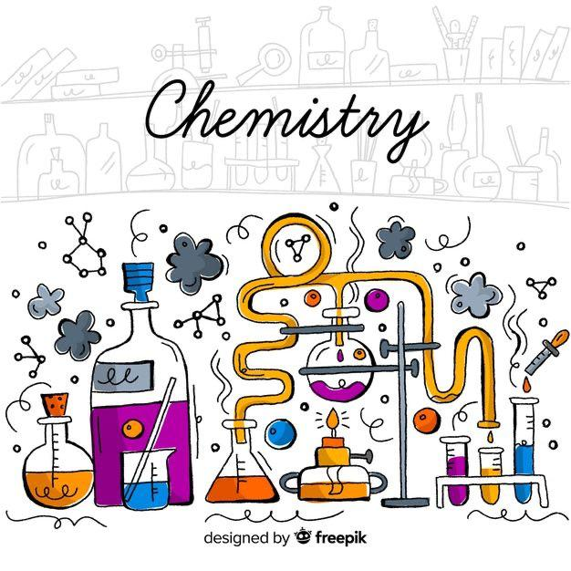
Part 2:chemical kinetics
Chapter 2: rate of the reaction

Slide 2
Objectives:
Define the rate of the reaction.
Define according to a kinetic curve the average rate, instantaneous and initial rate of formation of products or the disappearance of reactants.

Slide 3
According to the parameter of time we can distinguish 2 types of chemical reaction :
reaction
slow
(evolves slowly)
fast
(evolves instantaneously)

Slide 4
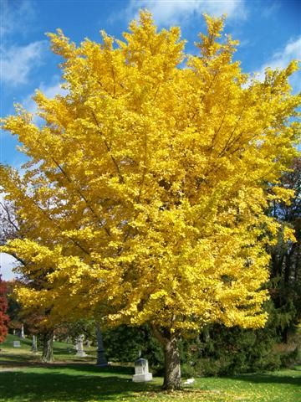
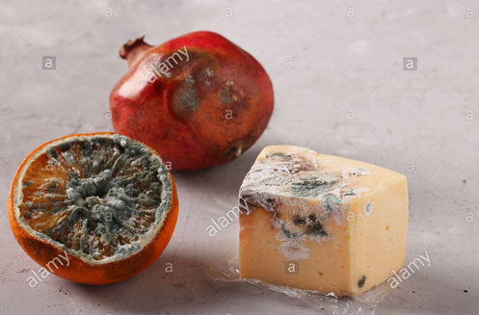

Example:
Slow reactions from our daily life

Slide 5
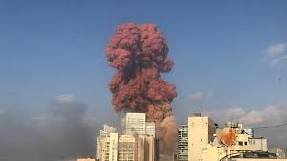

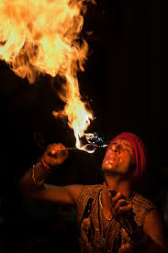
Fast reaction in our daily life.

Slide 6

1-Definition:
The chemical kinetics is the study of the progress of a chemical reaction as a function of time.
Only slow reactions are considered in the chemical kinetics.

Slide 7
What is the rate of the reaction?
It’s the amount of disappeared reactants or formed products during an interval of time.

Slide 8
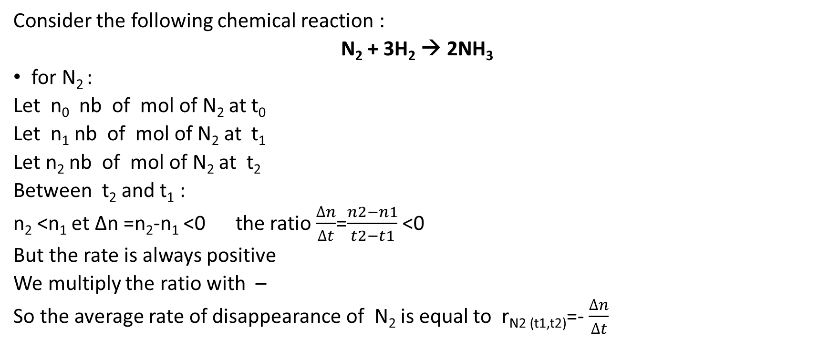
2-Rate of formation and rate of disappearance:
Consider the following chemical reaction :
N₂ + 3H₂ → 2NH₃
for N₂ :
Let n₀ nb of mol of N₂ at t₀
Let n₁ nb of mol of N₂ at t₁
Let n₂ nb of mol of N₂ at t₂
Between t₂ and t₁ :
n₂ <n₁ et ∆n =n₂-n₁ <0 the ratio $\frac{∆n}{∆t}$=$\frac{n2−n1}{t2−t1}$ <0
But the rate is always positive
We multiply the ratio with –
So the average rate of disappearance of N₂ is equal to r_{N2 (t1,t2)}=-$\frac{∆n}{∆t}$

Slide 9

2.1-Average rate of disappearance :
The average rate of disappearance of a reactant during an interval of time Δt is equal to:
$\overline{r}$(R) = -$\frac{∆n(R)}{∆t}$

Slide 10

2.2-Instantaneous rate of disappearance:
The instantaneous rate of disappearance of a reactant at instant t is equal :
r (R)_{t} = - $\frac{dn (R)}{dt}$

Slide 11
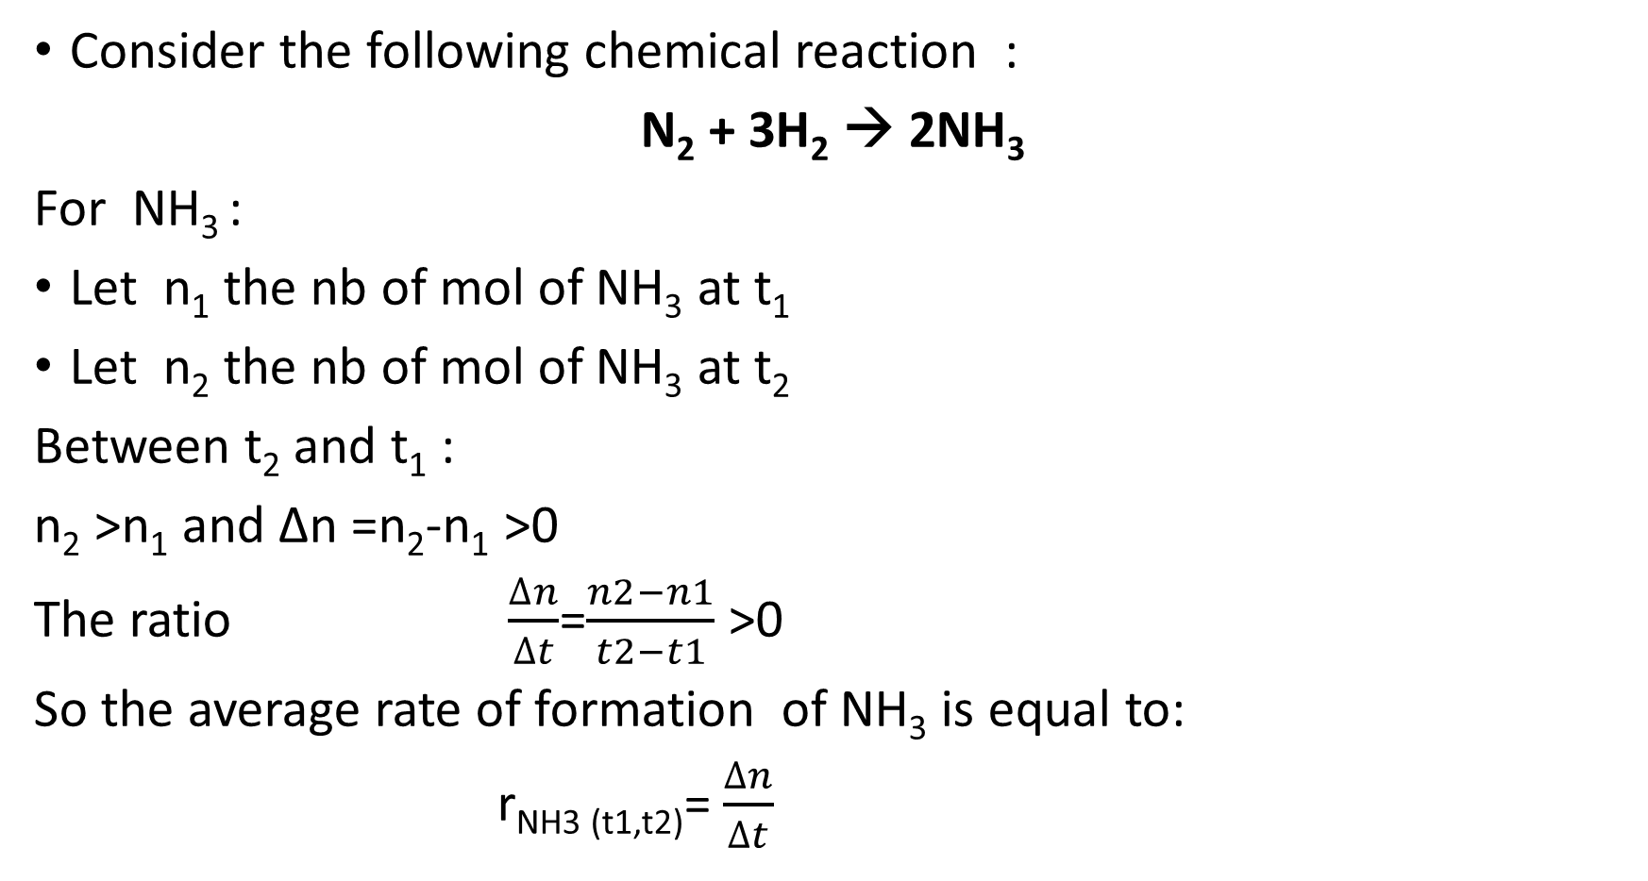
Consider the following chemical reaction :
N₂ + 3H₂ → 2NH₃
For NH₃ :
Let n₁ the nb of mol of NH₃ at t₁
Let n₂ the nb of mol of NH₃ at t₂
Between t₂ and t₁ :
n₂ >n₁ and ∆n =n₂-n₁ >0
The ratio $\frac{∆n}{∆t}$=$\frac{n2−n1}{t2−t1}$ >0
So the average rate of formation of NH₃ is equal to:
r_{NH3 (t1,t2)}=$\frac{∆n}{∆t}$

Slide 12

2.3-average rate of formation:
The average rate of formation of a product during an interval of time Δt is :
$\overline{r}$(P)=$\frac{Δn(P)}{Δt}$

Slide 13

2.4-Instantaneous rate of formation:
The instantaneous rate of formation of a product at an instant t is :
r(P)_{t}=$\frac{dn(P)}{dt}$

Slide 14
Remark:
The rate also can be expressed in terms of changes in concentration, by dividing each of the previous relations by the volume V

Slide 15
2.5-Unit of the rate of a reaction:
In function of number of mol : mol.time⁻¹
In function of concentration : mol.L⁻¹.time⁻¹
Time can be : s , min , h

Slide 16


Summary :
Average rate of disappearance :
Average rate of formation:
$\overline{r}$(R) = - $\frac{∆n(R)}{∆t}$
Or
$\overline{r}$(R) = - $\frac{∆[R]}{∆t}$
$\overline{r}$(P)=$\frac{Δn(P)}{Δt}$
Or
$\overline{r}$(P)=$\frac{Δ[P]}{Δt}$

Slide 17


summary:
Instantaneous rate of disappearance:
Instantaneous rate of formation:
r(R) = - $\frac{dn(R)}{dt}$
Ou
r(R) = - $\frac{d[R]}{dt}$
r(P)=$\frac{dn(P)}{dt}$
Ou
r(P)=$\frac{d[P]}{dt}$

Slide 18
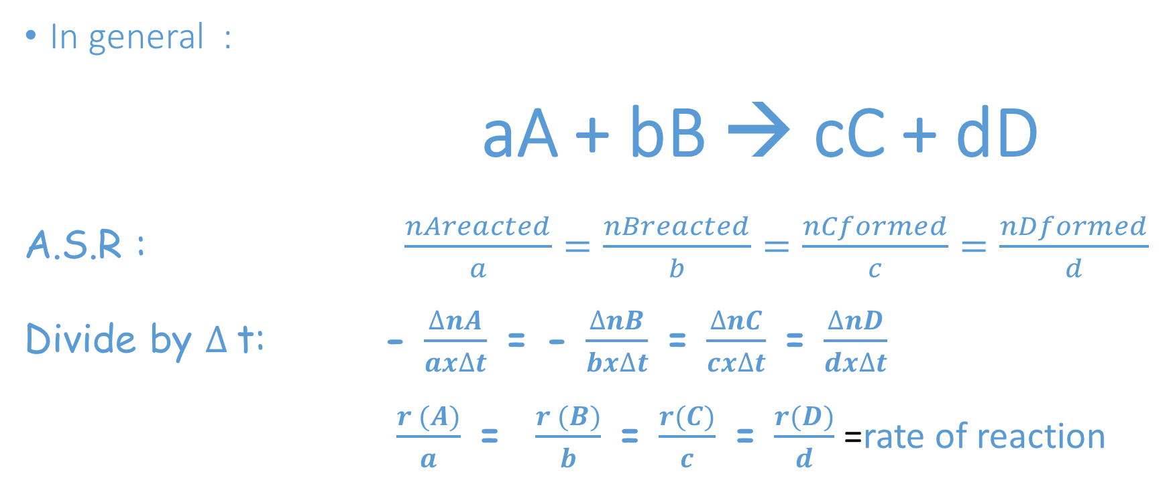
2.6-Rate of reaction and stoichiometric:
In general :
aA + bB → cC + dD
A.S.R : $\frac{nAreacted}{a}=\frac{nBreacted}{b}=\frac{nCformed}{c}=\frac{nDformed}{d}$
Divide by $∆$t: - $\frac{∆nA}{ax∆t}$ = - $\frac{∆nB}{bx∆t}$ = $\frac{∆nC}{cx∆t}$ = $\frac{∆nD}{dx∆t}$
$\frac{r (A)}{a}$ = $\frac{r (B)}{b}$ = $\frac{r(C)}{c}$ = $\frac{r(D)}{d}$=rate of reaction

Slide 19
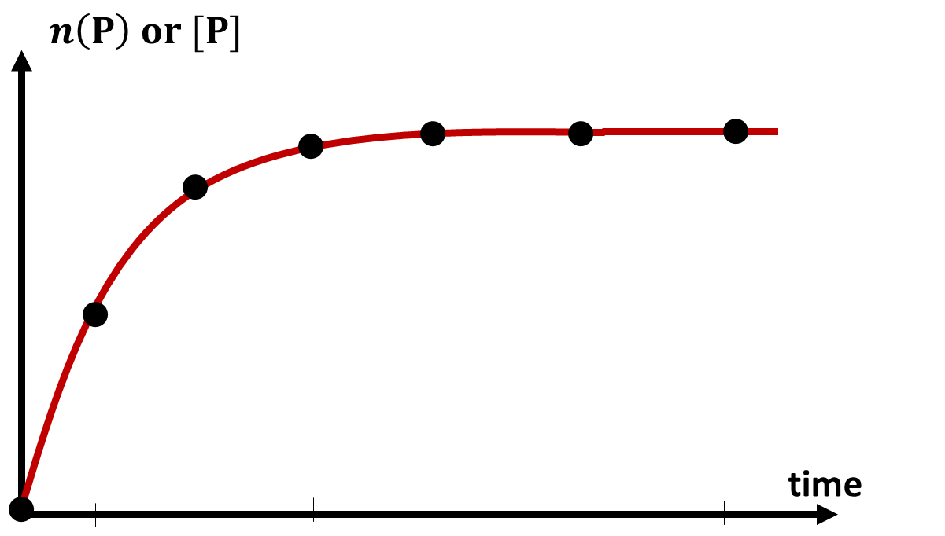
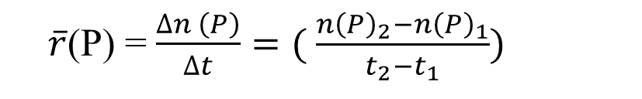
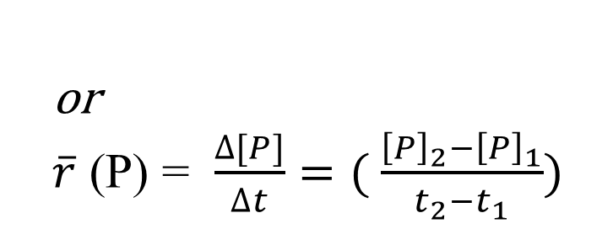
3-Kinetic curve:
$\overline{r}$(P) = $\frac{∆n \left(P\right)}{∆t}=( \frac{{n\left(P\right)}_{2}−{n\left(P\right)}_{1}}{t_{2}−t_{1}})$
or
$\overline{r}$ (P) = $\frac{∆[P]}{∆t}=( \frac{{\left[P\right]}_{2}−{\left[P\right]}_{1}}{t_{2}−t_{1}})$
3.1-Rate of formation of a product:
3.1.1-Average rate:
The average rate of formation of a product P within the interval of time Δt = t₁-t₁ is equal to the slope of the secant on the curve ]P[ = f(t) at the points of abscissa t₁ and t₂, respectively.
M₂
n₂
M₁
n₁
t₁
t₂

Slide 20
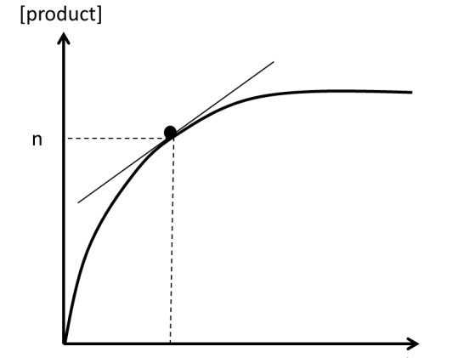
3.1-Rate of formation of a product
3.1.2-Instantaneous rate:
The instantaneous rate of formation of a product P at the time t is equal to the value of the slope of the tangent to the curve ]P[ = f(t) at the point of abscissa t

Slide 21
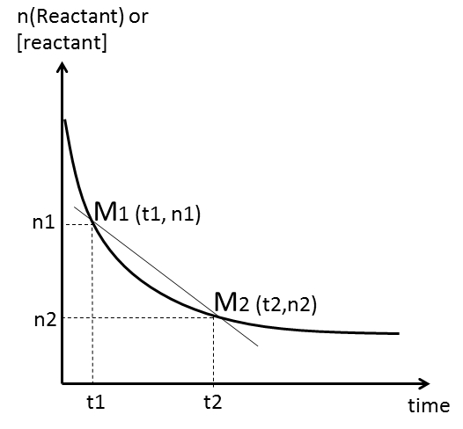
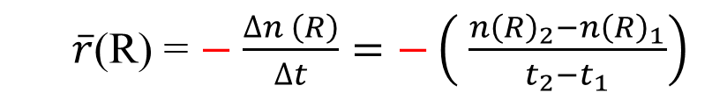
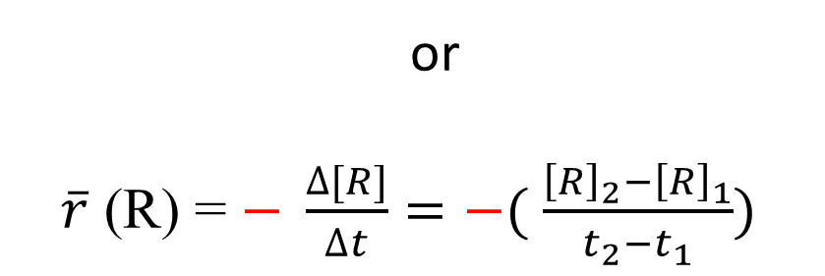
3-Kinetic curve:
$\overline{r}$(R) = $−$ $\frac{∆n \left(R\right)}{∆t}=−\left( \frac{{n\left(R\right)}_{2}−{n\left(R\right)}_{1}}{t_{2}−t_{1}}\right)$
or
$\overline{r}$ (R) = $− \frac{∆[R]}{∆t}=−( \frac{{\left[R\right]}_{2}−{\left[R\right]}_{1}}{t_{2}−t_{1}})$
3.2-Rate of disappearance of a reactant:
3.2.1-Average rate:
The average rate of disappearance of a reactant R within the interval of time Δt = t₁-t₁ is equal to the negative slope of the secant on the curve ]R[ = f(t) at the points of abscissa t₁ and t₂, respectively

Slide 22
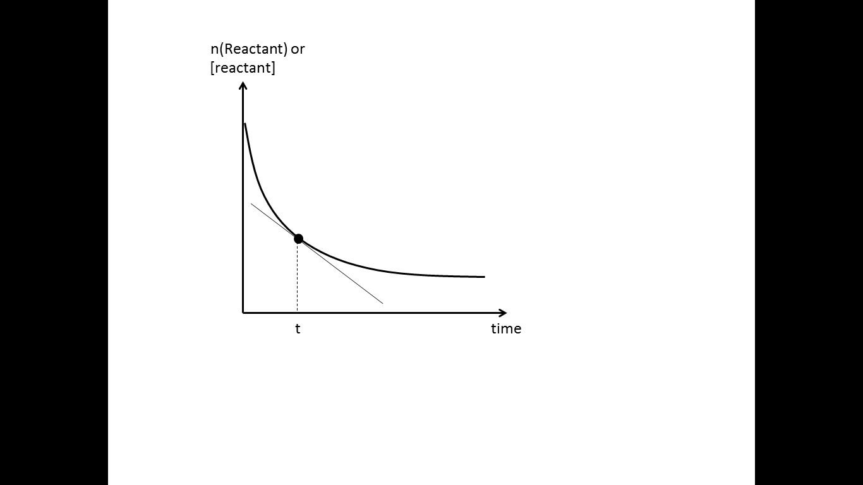
3.2-Rate of disappearance of a reactant
3.2.2-Instantaneous rate:
The instantaneous rate of disappearance of a reactant R at the time t is equal to the negative slope of the tangent to the curve ]R[ = f(t) at the point of abscissa t.

Slide 23
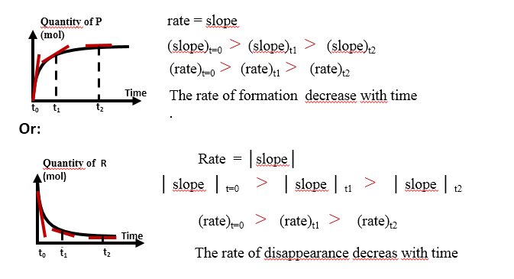
4-Variation of rate of a chemical reaction:

Slide 24
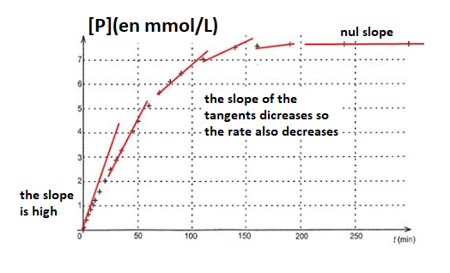
The rate of the reaction is high at the beginning and diminishes with time to become zero at the end of the reaction.

